Slide 1
Developing Academic & Performance Assessments

Slide 2
Assessments
Academic Tests
Evaluates cognitive skills, knowledge, understanding, ability to analyze and synthesize information into a new product.
Performance Assessments
Evaluates physical skills, ability to replicate movement, modify physical actions, and autonomously perform skills.

Slide 3
Cognitive Domain Remembering
Defines describes lists matches names recalls selects states

Slide 4
Cognitive Domain Understanding
converts defends Distinguishes estimates explains generalizes gives examples of infers interprets
Paraphrases rewrites summarizes

Slide 5
Cognitive Domain Applying
Applies changes computes constructs demonstrates
manipulates modifies operates prepares predicts
produces shows solves uses

Slide 6
Cognitive Domain Analyzing
analyses breaks down COMPARES Contrasts diagrams differentiates distinguishes identifies illustrates relates separates

Slide 7
Cognitive Domain Evaluating
Appraises compares concludes Contrasts criticizes
Critiques defends evaluates interprets justifies
Summarizes supports

Slide 8
Cognitive Domain Creating
Categorizes compiles combines COMPOSES creates
devises designs explains generates modifies Organizes
plans rewrites rearranges, reconstructs relates reorganizes revises summarizes writes

Slide 9
Psychomotor Domain Imitation
Copy follow replicate REPEAT mimic imitate reenact

Slide 10
Psychomotor Domain Manipulation
Recreate build perform execute IMPLEMENT

Slide 11
Psychomotor Domain Precision
Demonstrate complete control perfect PERFORM Show

Slide 12
Psychomotor Domain Articulation
Construct solve COMBINE coordinate integrate adapt develop formulate Modify Improve

Slide 13
Psychomotor Domain Naturalization
Design specify Manage REACT

Slide 14
Affective Domain Receiving
ask chooses DESCRIBES Follows gives Holds selects relies uses

Slide 15
Affective Domain Responding
Answers assists AIDS Complies conforms Performs practices presents reads Recites reports SELECTS Tells writes

Slide 16
Affective Domain Valuing
Completes demonstrates differentiates EXPLAINS follows Forms initiates Invites joins Justifies Proposes reads reports SELECTS Studies works

Slide 17
Affective Domain Organization by Values
Alters Adheres arranges COMBINDS Compares completes Defends explains formulates identifies Integrates modifies Organizes Prepares relates synthesizes

Slide 18
Affective Domain Characterization by Values
Acts discriminates DISPLAYS influences listens Modifies Performs practices proposes qualifies Questions revises SERVES Solves verifies

Slide 19
Item Identification
Item to be Tested
Identify job-related Item
Identify required / recommended level of learning.
Item tested at same level of learning as stated in objective.

Slide 20
Practical Exercise
Use Appendix A and a copy of an academic lesson plan to:
Review the objectives for their course;
Identify and list the task-related knowledge items indicated in the objective; and
Identify the domain to which it belongs, and the level of learning it represents.
Time for exercise is 15 minutes.

Slide 21
Test Item Linkage to Objective
Ensure item is linked to an objective
Objective
Item to be Tested
Ensure item is tested at the same learning level as the objective

Slide 22
Parts of Questions Stem
Stems must provide the central theme of the question.
Stems must be related to Instructional Objective.
Only one theme is addressed per question.
Stems must contain clear wording.
STEM

Slide 23
Examples of Stems
STEM
Which of the following describes Probable Cause?
The purpose of a Preliminary Hearing is to:
All of the following are elements of Assault except:
STEM

Slide 24
One Correct Answer
Possible Answer
Incorrect Answer
Possible Answer
Incorrect Answer
STEM
One Correct Answer
Possible Answer
Possible Answer
Incorrect Answer

Slide 25
Plausible but Incorrect Distractors
All distractors must be plausible but incorrect.
No ‘little brown dog’ distractors.
Which of the following is a fruit?
Broccoli
Bananas
Cauliflower
Little brown dogs

Slide 26
Multiple Choice Questions
Advantages
Disadvantages
Tests a wide range of training objectives.
Guessing is reduced.
A range of thinking skills may be tested.
Composing effective test items is difficult.
Presents fixed options.
Limits Creativity.
Writing plausible distracters can be challenging.

Slide 27
Incomplete-Statement Multiple-Choice
A variation of the Multiple-Choice question
Presents an incomplete statement and a set of standard options
Unreasonable searches and seizures are prohibited by the ___ ___.
Second Amendment
Fourth Amendment
Fifth Amendment
Sixth Amendment

Slide 28
Matching
Match the letters of the definitions in the right column with the terms in the left column.
___Reasonable Suspicion | A. Proof that exceeds that of a reasonable and normal doubt.
___Probable Cause | B. At first glance, the evidence appears sufficient.
___Prima Facie | C. Articulatable facts and circumstances that indicate that criminal behavior is afoot.
 | D. Facts and circumstances that indicate that a specific individual has committed a particular offense.

Slide 29
True False
Advantages
Disadvantages
Can be scored quickly and reliably.
Can be reliable and valid
Is generally easier to write than a multiple-choice item.
May help uncover popular misconceptions or common mistakes.
Tests tend to contain more true items than false items, leading to more “True” guesses.
May be limited to testing lower levels of learning.
Produces a lower chance of guessing incorrectly, and a higher chance of guessing correctly.

Slide 30
Application Questions
Errors & Omissions Question
Graphic Scenario Question

Slide 31
Exclusionary Questions
Stem contains a negative qualifier that seeks to identify the item that does not belong with a set of correct answers.
All the following are law enforcement intelligence centers except:
A. MAGLOCLEN
B. Delaware Valley Intelligence Center
C. Center for Missing & Exploited Children
D. Pennsylvania Criminal Intelligence Center

Slide 32
Exclusionary Questions
Which of the following is not a prohibited offensive weapon?
Hand-grenade
Semi-auto pistol
Sawed-off shotgun
Switchblade knife

Slide 33
Exclusionary Questions
Advantages
Disadvantages
Requires participants to recognize the answer that is incorrect.
Forces test takers to think differently about the correct and incorrect answers.
Provides some variety to the test format.
Some test takers have difficulty answering “negatively stated” questions.
The question can be confusing if it is not stated well.

Slide 34
Practical Exercise
Use Appendix B and a copy of an academic lesson plan to write stems for five different types of questions.
Questions will match the levels of learning reflected in the objective to which it relates.
Assessment criteria: Which level of learning; question stems are related to objectives, address one theme per stem.
Participants will use the Rubric contained in Appendix C to debrief exercise.
Participants will use their subject matter to write answers and distractors for the five different types of questions previously written. Answers and distractors will reflect the appropriate levels of learning.
Time allotted 20 minutes.

Slide 35
Content Validity
Lesson Plan
Test Question
Does the lesson plan
contain content that
sufficiently answers
the questions?

Slide 36
Practical Exercise
Review the Content Validity Table in Appendix D.
Using Appendix E (blank table); the academic lesson plan; and five test questions from your test bank, complete the top portion of Appendix E to assess and record the linkage of instructional objectives with their test questions and lesson plan content.
Time for exercise is 10 minutes.

Slide 37
Test Construction
Representation of Instructional Objectives

Slide 38
Representation of Instructional Objectives
Testing Objectives
Test all or most of the objectives.
Avoid testing one or more objectives heavily while not testing others.

Slide 39
Representation of Instructional Objectives
Distribution of Objective Related Questions
Distribution of objective-related questions should be representative of the amount of time the objectives received in the program.

Slide 40
Practical Exercise
Use the “Instructional Objectives Count” portion of the Content Validity Table in Appendix E and the 5 test questions from the academic lesson plan test bank to assess the representation and distribution of test items related to objectives.
Time for exercise is 5 minutes.

Slide 41
Test Construction
Representation of Instructional Objectives
Topical Area Distribution

Slide 42
Test Construction
Representation of Instructional Objectives
Topical Area Distribution
Levels of Learning

Slide 43
Test Construction
Representation of Instructional Objectives
Effective Answer Distribution
Topical Area Distribution
Levels of Learning

Slide 44
Effective Answer Distribution
Equal Distribution
Close to Equal Distribution
Correct Answer | # Questions
A | 5
B | 5
C | 5
D | 5
Total | 20
Correct Answer | # Questions
A | 5
B | 4
C | 6
D | 5
Total | 20

Slide 45
Ineffective Answer Distribution
Ineffective Distributions
Correct Answer | # Questions
A | 0
B | 16
C | 2
D | 2
Total | 20
Correct Answer | # Questions
A | 0
B | 8
C | 1
D | 11
Total | 20

Slide 46
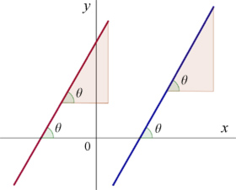
Distractor Paradigms
Nearly equal distractor length
Jfkljdsfjfjlfjjfjfjdfljfljfljfljgff
Uwruwruworiuweriouweru
Nnxv,mnvmxmnvnxmv
7353498734573483474

Slide 47
Distractor Paradigms
Nearly equal distractor length
Chronological Order
When does a defendant receive notice of the charges he is facing?
At the jail when being booked.
At the Preliminary Arraignment.
At the end of the Preliminary Hearing.
At the criminal trial.

Slide 48
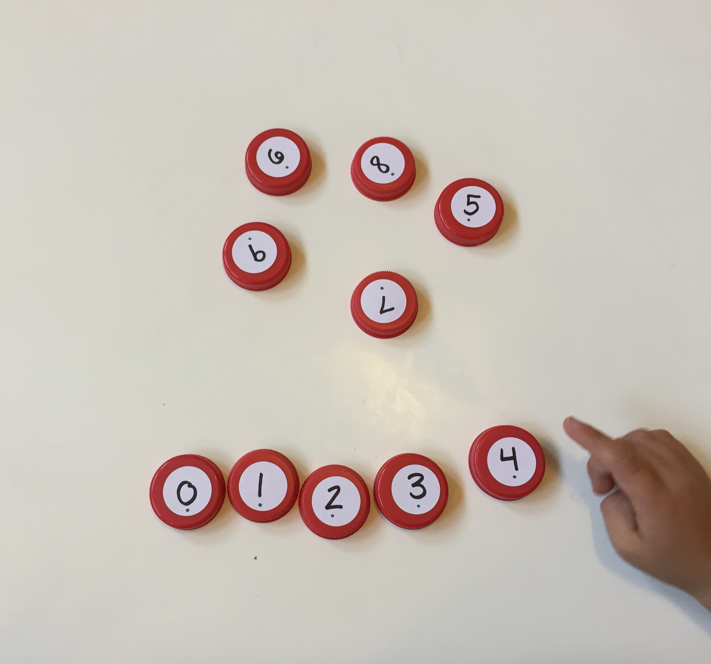
Distractor Paradigms
Nearly equal distractor length
Chronological Order
Numerical Order
Which of the following is the legal BAC limit for intoxication in Pennsylvania?
.001
.01
.1
1.0

Slide 49
Distractor Paradigms
Nearly equal distractor length
Chronological Order
Numerical Order
Shortest to Longest or vise versa
Jfkljdsfjfjlfjjfjfjdfljfljfl
Nnxv,mnvmxmnvnxmv
73534987345734834749
Uwruwruworiuweriouweruuio
Uwruwruworiuweriouweruuio
73534987345734834749
Nnxv,mnvmxmnvnxmv
Jfkljdsfjfjlfjjfjfjdfljfljfl

Slide 50
Test Item Analysis
Review the incorrect responses to gauge difficulty and correct problem questions or distractors.
Review the correct responses to determine if the level of difficulty is too low.
If the difficulty of a question is too low, either increase the difficulty by writing distractors at a higher level of difficulty, or replace the question.

Slide 51
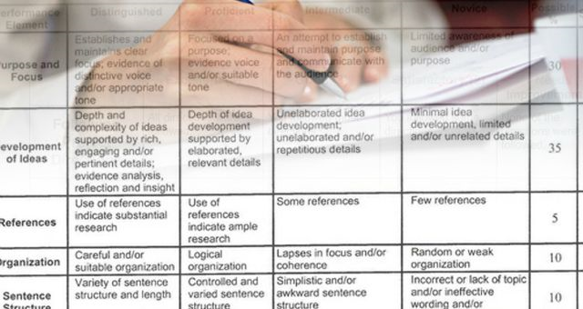
Rubrics
Holistic
Analytic
Weighted Scale

Slide 52
Assessment Functions
Skill Identification
Identify job-task related skills which need to be mastered.
Identify level of performance.
Test skill at same level as stated in the objective.
When needed, break skill into component sub-sets.

Slide 53
Assessment Functions
Skill Identification
Linkage to Objectives
Verify the linkage between performance objective and physical skill.
Ensure that the skill is written at the same level as the stated objective to which it relates.

Slide 54
Assessment Functions
Skill Identification
Linkage to Objectives
Learning Level
Determine appropriate level of performance.
Minimal level- Precision
Desired Level- Articulation

Slide 55
Assessment Functions
Skill Identification
Linkage to Objectives
Learning Level
Criteria Development
Criteria defines successful skill attainment
Uses performance levels
Defines condition, performance, standard for skill

Slide 56
Quantitative Criteria
Skill successfully performed to a minimum standard, e.g. 3 out of 5 attempts.
Skill successfully performed within a specified time.

Slide 57
Quantitative Criteria Condition
Handgun Draw Speed
Starting with a secured weapon, and hands clasped in front of the body, cadet demonstrates the ability to draw and place a hit within the scoring area of a TQ 21 target at 4 yards in 2.5 seconds from an audible signal, 2 out of 3 consecutive attempts.

Slide 58
Quantitative Criteria Performance
Starting with a secured weapon, and hands clasped in front of the body, cadet demonstrates the ability to draw and place a hit within the scoring area of a TQ 21 target at 4 yards in 2.5 seconds from an audible signal, 2 out of 3 consecutive attempts.

Slide 59
Quantitative Criteria Standard
Starting with a secured weapon, and hands clasped in front of the body, cadet demonstrates the ability to draw and place a hit within the scoring area of a TQ 21 target at 4 yards in 2.5 seconds from an audible signal, 2 out of 3 consecutive attempts.

Slide 60
Qualitative Criteria
Skill successfully performed consistently and effectively
Skill performed in the correct sequence
Skill performed at the appropriate time
Skill performed in the appropriate manner

Slide 61
Qualitative Criteria Condition
Stoppage Clearance, Phase 2
Starting with a “failure to extract” simulation using an inert practice round in the chamber and an inert practice round as the top round in the magazine with the slide pushing this round forward, weapon at eye level, and a fresh magazine secured in a pouch, cadet properly clears the stoppage (starting with “TAP-RACK-READY” and proceeding to “LOCK-RIP-WORK-TAP-RACK-READY,” and firing 1 shot.

Slide 62
Qualitative Criteria Performance
Starting with a “failure to extract” simulation using an inert practice round in the chamber and an inert practice round as the top round in the magazine with the slide pushing this round forward, weapon at eye level, and a fresh magazine secured in a pouch, cadet properly clears the stoppage (starting with “TAP-RACK-READY” and proceeding to “LOCK-RIP-WORK-TAP-RACK-READY,” and firing 1 shot.

Slide 63
Qualitative Criteria Standard
Starting with a “failure to extract” simulation using an inert practice round in the chamber and an inert practice round as the top round in the magazine with the slide pushing this round forward, weapon at eye level, and a fresh magazine secured in a pouch, cadet properly clears the stoppage (starting with “TAP-RACK-READY}” and proceeding to “LOCK-RIP-WORK-TAP-RACK-READY,” and firing 1 shot.

Slide 64
Multi-Modal Criteria Condition
Starting with a “failure to extract” simulation using an inert practice round in the chamber and an inert practice round as the top round in the magazine with the slide pushing this round forward, weapon at eye level, and a fresh magazine secured in a pouch, cadet properly clears a Phase 2 stoppage (starting with “TAP-RACK-READY” and proceeding to “LOCK-RIP-WORK-TAP-RACK-READY,)” within 10.0 seconds.

Slide 65
Multi-Modal Criteria Qualitative Performance
Starting with a “failure to extract” simulation using an inert practice round in the chamber and an inert practice round as the top round in the magazine with the slide pushing this round forward, weapon at eye level, and a fresh magazine secured in a pouch, cadet properly clears a Phase 2 stoppage (starting with “TAP-RACK-READY” and proceeding to “LOCK-RIP-WORK-TAP-RACK-READY,)” within 10.0 seconds.

Slide 66
Multi-Modal Criteria Quantitative Standard
Starting with a “failure to extract” simulation using an inert practice round in the chamber and an inert practice round as the top round in the magazine with the slide pushing this round forward, weapon at eye level, and a fresh magazine secured in a pouch, cadet properly clears a Phase 2 stoppage (starting with “TAP-RACK-READY)” and proceeding to “LOCK-RIP-WORK-TAP-RACK-READY,” within 10.0 seconds.

Slide 67
Practical Exercise
Use Appendix G to: Identify two skills items to be assessed; Develop criteria defining performance; Develop one criterion for the Precision, and one for the Articulation level of the psychomotor learning domain.
Use Appendix C to debrief exercise.
Time allotted 10 Minutes

Slide 68
Assessment Functions
Skill Identification
Linkage to Objectives
Learning Level
Criteria Development
Types of Assessments
Checklists / Criteria
Rubrics

Slide 69
Assessment Functions
Skill Identification
Linkage to Objectives
Learning Level
Criteria Development
Types of Assessments
Content Validity
Compare assessment items and criteria with lesson plan content.
Does the training include specific information, coaching, and practice to produce the skill?

Slide 70
Practical Exercise
Complete Appendix E to assess the content validity of the skills lesson plan and assessment.
This is the same process as completed previously for test questions.
Time for exercise is 10 minutes

Slide 71
Assessment Functions
Skill Identification
Linkage to Objectives
Learning Level
Criteria Development
Types of Assessments
Content Validity
Assessment Construction
Test all or most objectives
Distribute Objective-related skills
Address all or most topics
Verify performance levels of objectives & skill assessments

Slide 72
Practical Exercise
Use the “Instructional Objectives Count” portion of the Content Validity Table in Appendix E to assess the representation and distribution of skill assessment items related to objectives.
Time for exercise is 5 minutes.

Slide 73
Assessment Functions
Skill Identification
Linkage to Objectives
Learning Level
Criteria Development
Types of Assessments
Content Validity
Assessment Construction
Item Analysis
Analyze several assessments to determine if failures or successes are too stringent or easy.

Slide 74
Assessment Functions
Skill Identification
Linkage to Objectives
Learning Level
Criteria Development
Types of Assessments
Content Validity
Assessment Construction
Item Analysis
Documentation

