Slide 1
Instructional Systems Design

Slide 2
ADDIE-R
Analysis
Design
Development
Implementation
Evaluation
Revision
Formative Evaluation

Slide 3
Analysis Phase
Identify a Training Need
Provides justification for training
Focuses the design and development of a training program
Establishes:
What needs to be taught
To whom it needs to be taught
The current and anticipated needs of those attending the program

Slide 4
Tasks Associated with the Analysis Phase
Identifying a Training Need
Does training meet needs?
Does it focus on individual duty requirements?
Does training bridge the gap between ability and need?

Slide 5
Identify Training Gap
Current Abilities
Training Gap
Needed Abilities

Slide 6
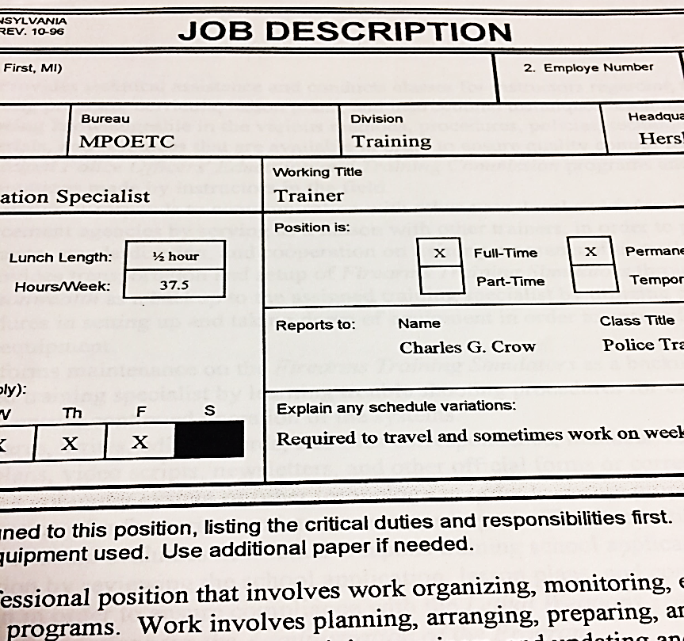
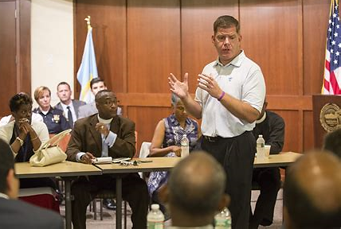
Methods of Determining Training Needs

Slide 7
Needs Extrapolation Mass Attacks
1966- Univ. of Texas, tower shooting.
1974- Ma’alot Israel school shooting.
1984- San Ysidro McDonald’s shooting.
1986- Post office shooting.
1989- School playground shooting.
1990- Jacksonville, Fl. Workplace shooting
1991-Luby’s café shooting.
1991- University of Iowa shooting.
1992- Lindhurst High School shooting.
1993- San Francisco workplace shooting.
1998- Jonesboro Ark. school shooting

Slide 8
Practical Exercise
Part 1. Use Appendix A titled: “Working Group” and a topical area that you teach to form a working group.
Compile a list of subject matter experts to serve on a working group that includes both law enforcement and specialized personnel as needed;
List resources to be used in developing, and vetting course content (e.g. Organizations, Training Entities;
List sources of information (research reports, recognized training websites, governmental entities, etc.
Part 2. Participants will repeat the above exercise using an assigned topical area that they do not teach.
Total time allotted for entire exercise - 15 minutes

Slide 9
Design Phase
Provides an organized process based on educational principles to provide structure to a program.
Tasks include:
Setting parameters
Identifying & organizing topics
Using domains & levels of learning.

Slide 10
Domains of Learning
Cognitive
Psychomotor
Affective
Attitudes, Willingness to consider, Active participation,
Internalizing values, Motivation, Value system

Slide 11
Cognitive Domain Remembering
Defines describes lists matches names recalls selects states

Slide 12
Cognitive Domain Understanding
converts defends Distinguishes estimates explains generalizes gives examples of infers interprets
Paraphrases rewrites summarizes

Slide 13
Cognitive Domain Applying
Applies changes computes constructs demonstrates
manipulates modifies operates prepares predicts
produces shows solves uses

Slide 14
Cognitive Domain Analyzing
analyses breaks down COMPARES Contrasts diagrams
differentiates distinguishes identifies illustrates relates separates

Slide 15
Cognitive Domain Evaluating
Appraises compares concludes Contrasts criticizes
Critiques defends evaluates interprets justifies
Summarizes supports

Slide 16
Cognitive Domain Creating
Categorizes compiles combines COMPOSES creates
devises designs explains generates modifies Organizes
plans rewrites rearranges, reconstructs relates reorganizes revises summarizes writes

Slide 17
Psychomotor Domain Imitation
Copy follow replicate REPEAT mimic imitate reenact

Slide 18
Psychomotor Domain Manipulation
Recreate build perform execute IMPLEMENT

Slide 19
Psychomotor Domain Precision
Demonstrate complete control perfect PERFORM Show

Slide 20
Psychomotor Domain Articulation
Construct solve COMBINE coordinate integrate adapt develop formulate Modify Improve

Slide 21
Psychomotor Domain Naturalization
Design specify Manage REACT

Slide 22
Affective Domain Receiving
ask chooses DESCRIBES Follows gives Holds selects relies uses

Slide 23
Affective Domain Responding
Answers assists AIDS Complies conforms Performs practices presents reads Recites reports SELECTS Tells writes

Slide 24
Affective Domain Valuing
Completes demonstrates differentiates EXPLAINS follows Forms initiates Invites joins Justifies Proposes reads reports SELECTS Studies works

Slide 25
Affective Domain Organization by Values
Alters Adheres arranges COMBINDS Compares completes Defends explains formulates identifies Integrates modifies Organizes Prepares relates synthesizes

Slide 26
Affective Domain Characterization by Values
Acts discriminates DISPLAYS influences listens Modifies Performs practices proposes qualifies Questions revises SERVES Solves verifies

Slide 27
Design Phase Tasks
Design Phase
Compile Objectives
Determine Scope
Outline Topics
Instructional Methods
Determine Time
Preliminary Test Material

Slide 28
Course Design Document
A Course Design Document
can assist developers in
designing and organizing training.
Is one way to
Organize elements
to be developed

Slide 29
Compile Objectives
A statement of what a student needs to be able to do by the end of a training program.
Terminal Objective
Enabling Objective

Slide 30
Terminal Objective Performance Clause
What should the participant be able to do?
"will prepare an affidavit for a search warrant.. ."
"will execute a search warrant... "
"will arrest a non-compliant suspect... "
"will conduct an interview of a witness.. ."
Terminal Objective

Slide 31
Terminal Objective Condition Clause
Under what conditions does the participant perform the action?
"Given a simulated crime scene...”
"During an interview situation..."
"While handcuffing a suspect...”
"Given a case study..."
Terminal Objective

Slide 32
Terminal Objective Standard Clause
By what standard will the participant’s performance be judged?
In accordance with…
Degree of Proficiency
Operational Procedures
Terminal Objective

Slide 33
Terminal Objective Example
Given role players and a mock arrest scenario, the participant will effect a lawful arrest in accordance with the PA Crimes Code and Rules of Criminal Procedure.

Slide 34
Practical Exercise
Refer to the Pre-Course handout titled “Domains” and Appendix C titled “Objectives.”
Use the verbs contained in the handout write two Terminal Objectives related to your primary area of instruction. The wording must reflect the Condition, Performance, and Standard paradigm.
Write two Terminal Objectives for your non-related topic of instruction as indicated in the “Working Group” exercise.
When completed, exchange papers and use Appendix D titled “Practical Exercise Rubric” to assess the structure of the objectives.
Time allotted for entire exercise - 20 minutes

Slide 35
Enabling Objectives
Enabling Objectives support Terminal Objectives.
Enabling Objectives and are necessary to the successful performance of the Terminal Objective.
Can be written more simply than Terminal Objectives.
If needed, can contain a Condition, Performance, and Standard.
Enabling Objective

Slide 36
Practical Exercise
Use
Use Appendix C titled “Objectives” to write two enabling objectives for each of the terminal objectives previously written.
Support
Enabling objectives must support the terminal objectives, and must be written at a lower level than the terminal objective.
Exchange
When completed, exchange papers and use the Rubric in Appendix D to assess the structure and composition of the objectives.
Total
Total time allotted for entire exercise- 20 minutes

Slide 37
Compile a Tentative Outline
List topical areas that provide adequate knowledge or skill sets to meet the objectives;
Develop a topical sequence; and
Compile a tentative outline.

Slide 38
Practical Exercise
Use
Use Appendix E titled: “Topical Outline” to compile a course outline.
Exchange
When completed, exchange papers and use the Rubric in Appendix D to assess the outline.
Time
Time allotted for exercise - 10 minutes

Slide 39
Select Instructional Methods
PowerPoint
Structured
Exercises
Videos
Problem
Solving
Exercises
Scenario
Debriefs

Slide 40
Practical Exercise
Use Appendix F (a blank copy of the “Course Design Matrix”) to:
Record a terminal objective and all supporting enabling objectives addressing one segment of training taken from Appendix C “Objectives;”
Make a partial list of topics to be taught;
Determine allotted time; and
List instructional methods.
Debrief the process as needed.
Time allotted for exercise - 20 minutes

Slide 41
Preliminary Assessment Items
Compile a list of general evaluation items addressing broad issues.
Items will serve as a guideline for content development.
Modify later.
Examples might include:
What are the duties of a first responder to a crime scene?
What types of information would an officer need to obtain from a witness to a crime?
How can officers de-escalate an individual experiencing a crisis?
How should officers conduct traffic stops?

Slide 42
Practical Exercise
Use Appendix F “Course Design Matrix” to:
Write preliminary test questions for the terminal objective and each enabling objective.
Total time allotted for entire exercise - 15 minutes.

Slide 43
Development Phase Overview
Design Phase Result
Development Phase Result

Slide 44
Development Phase
Compile Content
Use reputable sources to research topics
Use current information
Document sources
Use Reference section
Ensure information is relevant to tasks
Information is consistent with goals

Slide 45
Development Phase
Compile Content
Develop Lesson Plan

Slide 46
Lesson Plan Development
Preliminary pages containing Objectives, Table of Contents time allotment special notes;
Course content in an outline or other format;
Instructor notes providing process information;
List of References;
Appendices containing supplemental material, handouts, etc.

Slide 47
Practical Exercise
Refer to Appendix A “Working Group” exercise and review your list for any additional individuals and training organizations you can use to vet the lesson plan content, receive critical input from, and receive revision recommendations.
Revise the list if needed to include any additional entities or SMEs who may provide assistance in vetting course material.
Approximate time 5 minutes.

Slide 48
Development Phase
Compile Content
Develop Lesson Plan
Develop Instructional Aids

Slide 49
Development Phase
Compile Content
Develop Lesson Plan
Develop Instructional Aids
Develop Instructional Methods

Slide 50
Development Phase
Compile Content
Develop Lesson Plan
Develop Instructional Aids
Develop Instructional Methods
Develop Preliminary Assessments

Slide 51
Multiple Choice Questions
Possible Answer
Possible Answer
STEM
Possible Answer
Possible Answer

Slide 52
Development Phase
Compile Content
Develop Lesson Plan
Formative
Evaluation
Develop Instructional Aids
Develop Instructional Methods
Develop Preliminary Assessments
Conduct Linkage Analysis

Slide 53
Practical Exercise
Use your subject of instruction to select five final-form test questions from your topic’s test bank.
Use the Rubric on page 2 of Appendix D to assess the test questions.
Criteria for assessment will be:
Questions contain a Stem;
One correct answer;
Three plausible distractors.
Test Questions are related to an objective.
Approximate time 15 minutes.

Slide 54
Implementation Phase
Prepare for presentation of course
Conduct a Pilot Program
Handle logistics
Alternative review process

Slide 55
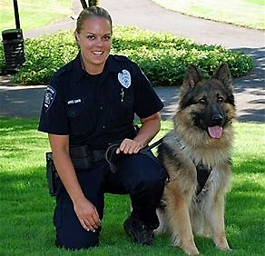
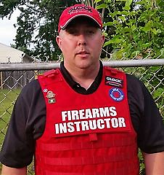
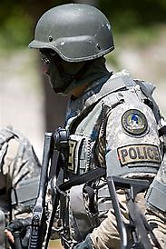
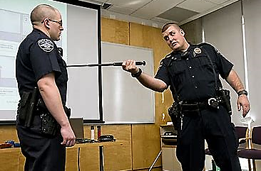
Implementation Phase
Conduct a Pilot Program
Subject Matter Experts and Instructors
Logistics
Target Audience

Slide 56
Evaluation Phase
Conduct Level 1 Evaluations
Evaluate participant performance on evaluations
Analyze assessment items

Slide 57
Areas to Assess
Topics
Structure of Course
Presentation Methods
Instructor Qualifications / Performance
Relevance of Course / Topics
Quality of Training Environment

Slide 58
Common Statements / Questions
Please indicate your level of satisfaction with how this training was presented. (Used with a satisfaction scale)
This training will enable me to perform my duties more effectively. (Used with an agreement scale)
To what extent will this training be helpful to you in performing your duties? (Used with a Helpfulness scale)

Slide 59
Likert Scales
An answer format that offers an inclusive range of options.
This range flows from one extreme to the other, and has various options within the range.
Typically, has an odd number of options, usually five, so that there is a neutral point in the middle of the two extremes.
Where it may be advisable to force participants to move off a neutral response, scale developers may choose to exclude the neutral response by having only four responses.

Slide 60
Common Responses
Satisfied vs. Dissatisfied
___Very satisfied
___Somewhat satisfied
___Neither satisfied nor dissatisfied
___Somewhat dissatisfied
___Very dissatisfied
Agree vs. Disagree
___Strongly agree
___Agree
___Neutral
___Disagree
___Strongly disagree
Helpful vs. Not Helpful
___Extremely helpful
___Very Helpful
___Neutral
___Not very helpful
___Not at all helpful

Slide 61
Practical Exercise
Use Appendix G to compose a 5-item list of Level 1 evaluation items and use or construct a Likert scale for each item.
Use the Rubric on page 2 of Appendix D to assess the Level 1 survey.
Approximate time 15 minutes.

Slide 62
Revision Phase
Use observations to improve training

Slide 63
Revision Phase
Use observations to improve training
Use Level 1 results to improve content

Slide 64
Revision Phase
Use observations to improve training
Use Level 1 results to improve content
Use Level 2 results to improve course evaluations

